Slide 1
Group 8 Movie Recommendation System
By
Chaturved Akash
Adarsh Hedge
Akshay Kowshik
Sai Abhishek Rupakula

Slide 2
Why Recommendation system?(Recap)
The information overload problem is solved by todays search engines, but they do not provide us with the personalized information.
Recommendation system provides personalized recommendations for each and every user.
For amazon prime, Netflix etc. it is not just streaming of movies, but they need to understand what the subscribes need and what their interests are which is a challenge for these online platforms.
Recommendation system has a key role to play In todays e-commerce industry(Books, music, podcasts)

Slide 3
Research Questions
Popularity Predictions
Genre prediction using text classification
Movie recommendation system based on content based filtering and collaborative filtering with SVD
Hybrid movie recommendation system

Slide 4

Popularity Prediction

Slide 5
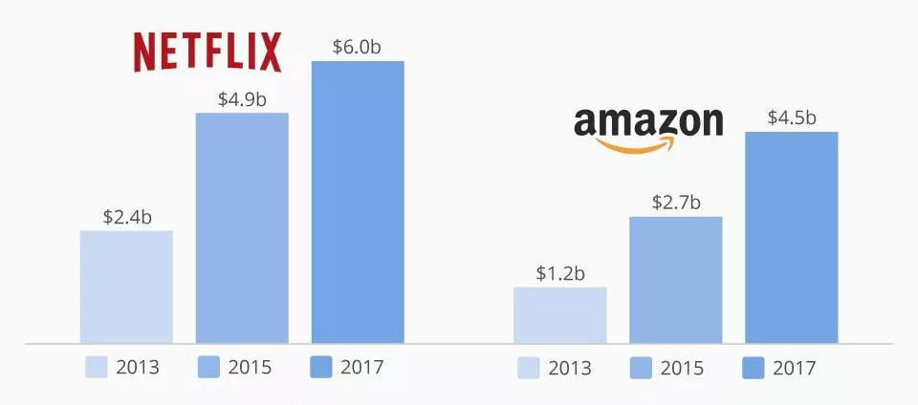
Popularity Prediction
Popularity of a movie has got a great importance to the online media streaming companies.
Popular movies tend to get more views hence more revenue.
We have built a linear regression model to predict the popularity score of each movies.

Slide 6
Process
Data
Analysis and Cleaning
Pre-processing
Train and Fit
We have used RMSE and MAE to evaluate the model. The minimum the RMSE value the better the model

Slide 7
Genres Prediction

Slide 8
Genres Prediction
Predicting the genre of the movie given the overview of the movie
Columns used are:
Genres
Overview

Slide 9
Process
columns
Identifying the most frequent words
Removing Stop words
Stemming
Lemmatization
Transform genre column using MultiLabelBinarizer
Model Evaluation
Hyper parameter tuning
Model Building
TF-IDF Vectorizer

Slide 10
RECOMMENDATION SYSTEMS

Slide 11
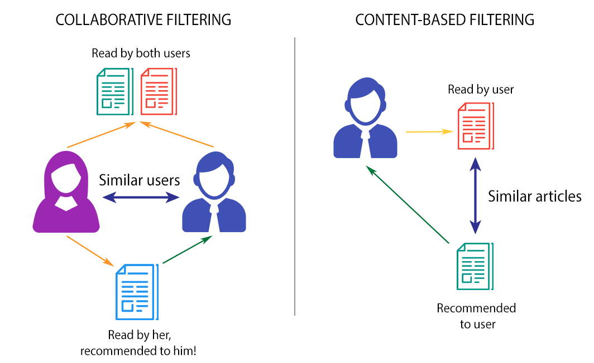
Types
There are two main types of recommendation systems
1. Content based
2. Collaborative Filtering
We have also built a third type of recommendation system where we combined both content and collaborative filtering and termed it Hybrid recommendation

Slide 12
Content based
Suggestions similar to the item which user liked.
Columns used are :-
Overview
Credits
Genres
Keywords

Slide 13
Process
column
TF-IDF MATRIX
Cosine Similarity
Result
Tf= No. of times Word appears in the document/total number of terms in the document
IDF = log( Total Number of documents/ number of times word appear in the document)
Cosine Similarity:-
Cos(Theta) = A.B / ||A||||B||
WHY COSINE SIMILARITY??
when modelling texts as vectors you will have many dimensions, thousands, the Euclidean distance is not very good for very high dimensional data.

Slide 14
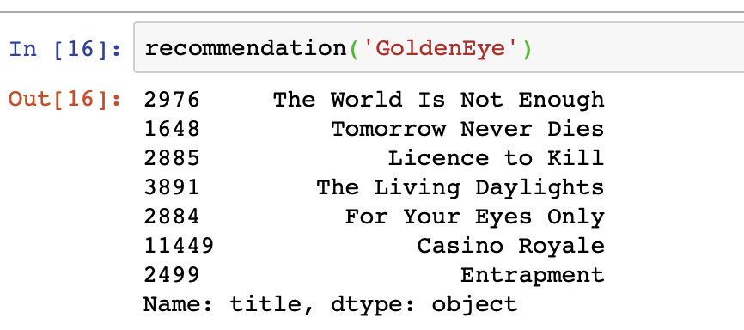
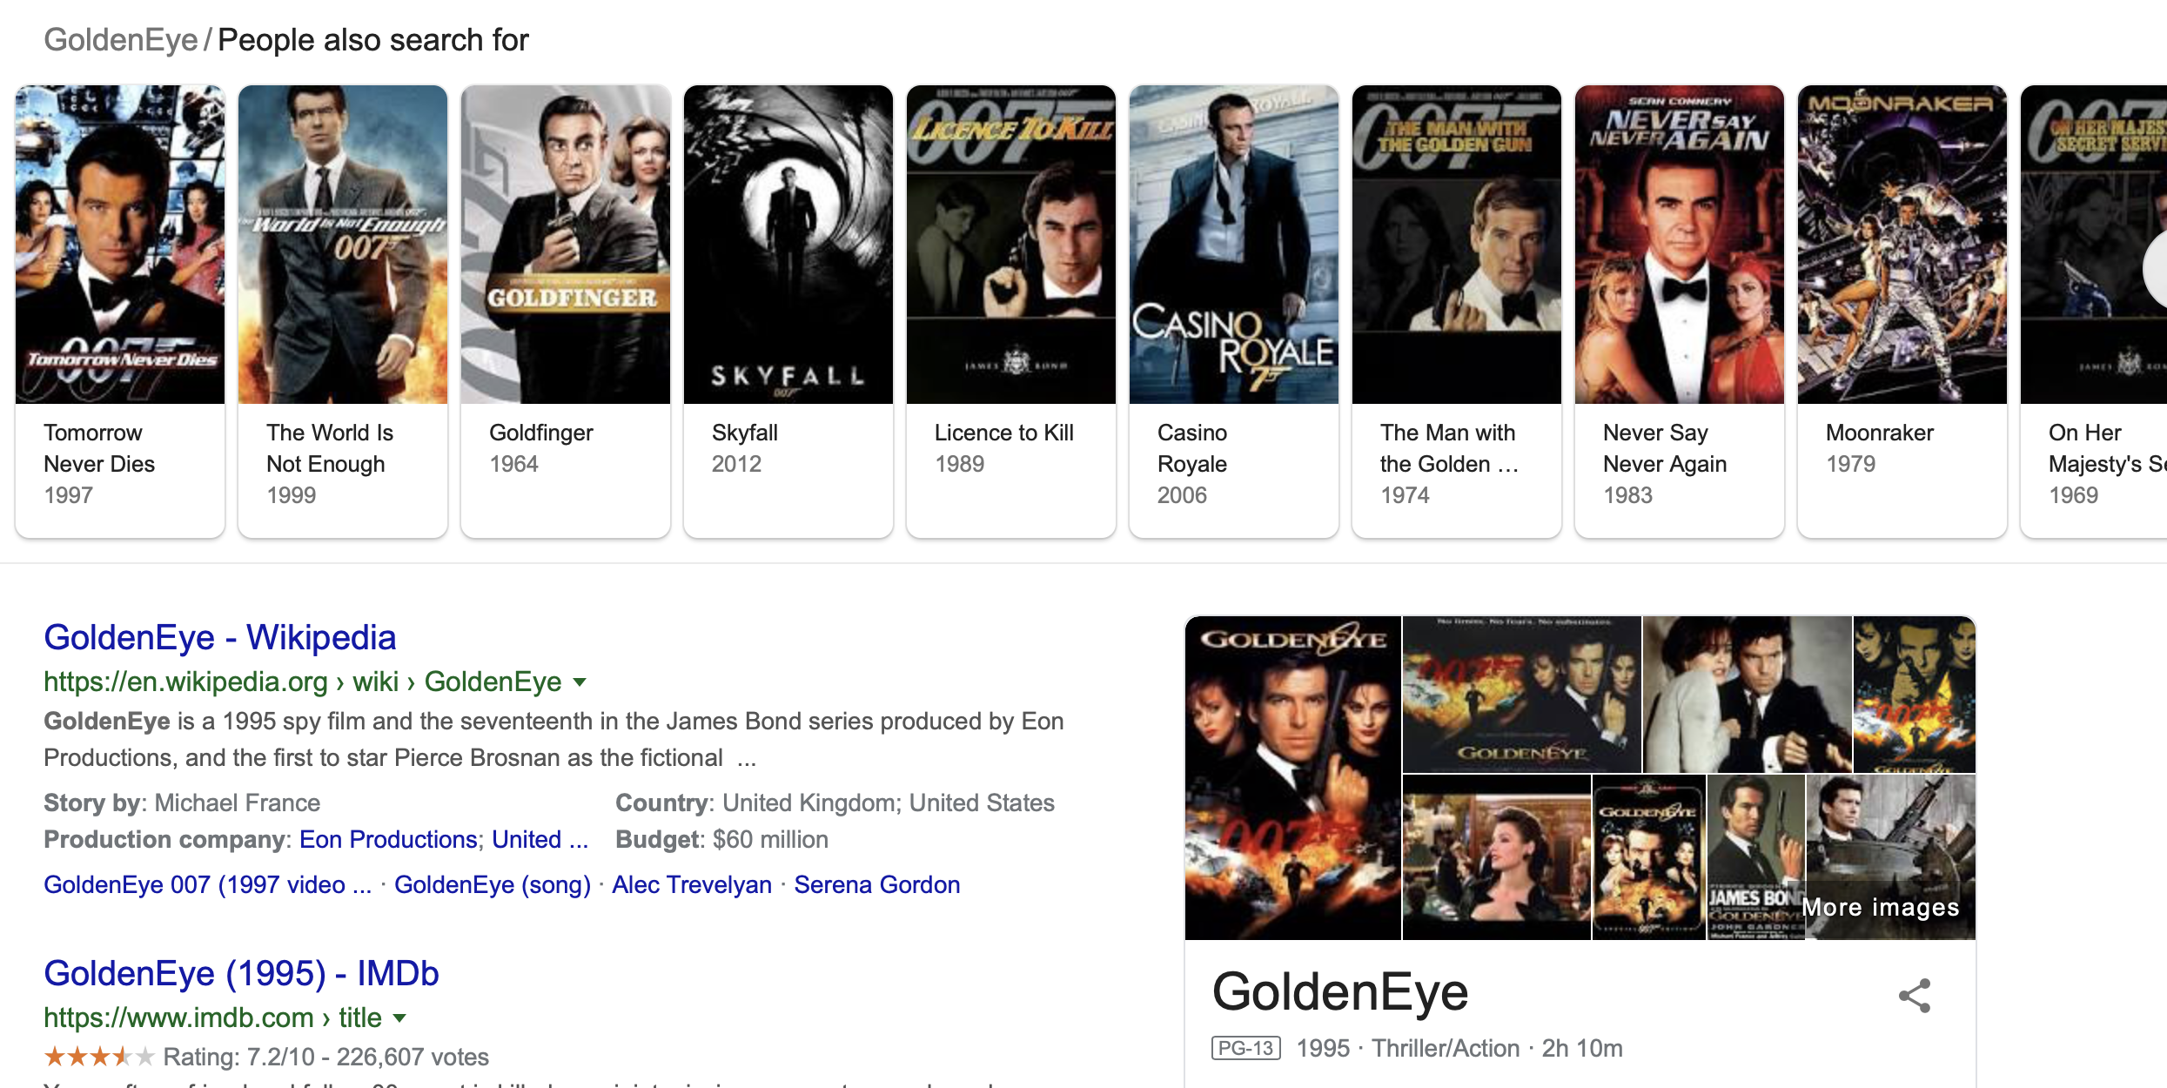

Slide 15
Collaborative
Matches with people with similar interests and captures the user's personal interests and tastes.
There are 2 types of Collaborative filtering:-
1) Memory based – User based ,Item Based
2) Model Based – SVD
Limitations of both User based, and item Based can be solved by Model Based collaborative filtering

Slide 16
Process
Columns considered are :-
1) UserID
2) MovieID
3) Rating
Data
Cross Validate
Evaluate SVD Model
Train and Fit
SVD is a matrix factorization technique that is usually used to reduce the number of features of a data set by reducing space dimensions and this by capturing the similarity between users and items.
We have used RMSE and MAE to evaluate the model.The minimum the RMSE value the better the model

Slide 17
Result

Slide 18
Hybrid Recommendation
Content Based Filtering
Similar movies to the given movie are identified.
Hybrid Recommendation
Based on the predicted ratings, top choices for the current user is returned.
Collaborative Filtering
In the set of similar movies, possible ratings by the given user are predicted; for the movies which are not rated by this user.
Combines the advantages of Content Based and Collaborative Recommendation.
For a movie given by the user, a set of similar movies are obtained via Content-Based Filtering.
In the set of similar movies, ones which are not rated by the current user are identified.
Possible ratings by the given user is predicted for each of these movies.
The movies corresponding to the top predicted ratings are returned as a hybrid recommendation for the given user.

Slide 19
Thank You.

